Slide 1

NSG Pilkington – University of Liverpool Machine Learning Project: 28/10/2020
Dr. Peter Green
Diego Echeverria
Risk Institute,
School of Engineering

Slide 2
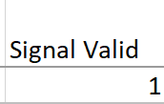
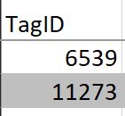
Load raw tag data if in Mark’s spreadsheet
Isolate to be between 21/09/19 and 25/10/19
Signal valid?
Is between mix and max range?
Is it marked as being low resolution?
no
=1
yes
=0
no
yes
Tag data we cannot find
Is it marked as containing spikes?
Does it require low-pass filtering?
no
no
no
Interpolation
Standardise
Time lags
Reversal?
yes
yes
yes
Filter

Slide 3
Load raw tag data if in Mark’s spreadsheet
Isolate to be between 21/09/19 and 25/10/19
Signal valid?
Is between mix and max range?
Is it marked as being low resolution?
no
=1
yes
=0
no
yes
Tag data we cannot find
Is it marked as containing spikes?
Does it require low-pass filtering?
no
no
no
Interpolation
Standardise
Time lags
Reversal?
yes
yes
yes
Filter

Slide 4
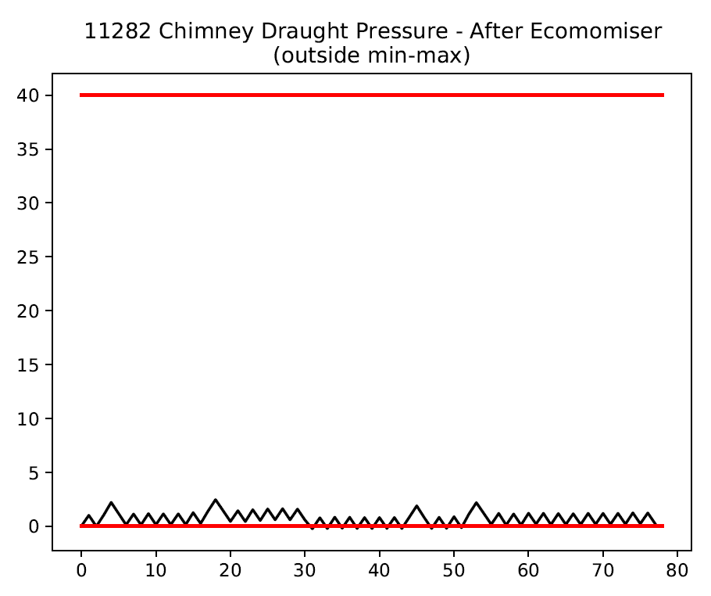
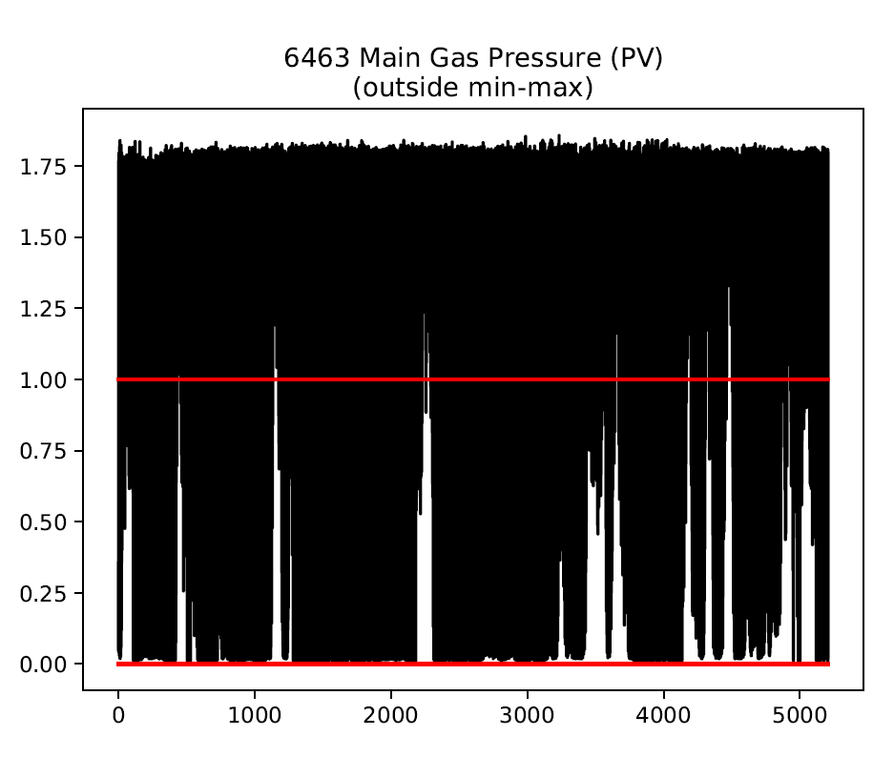
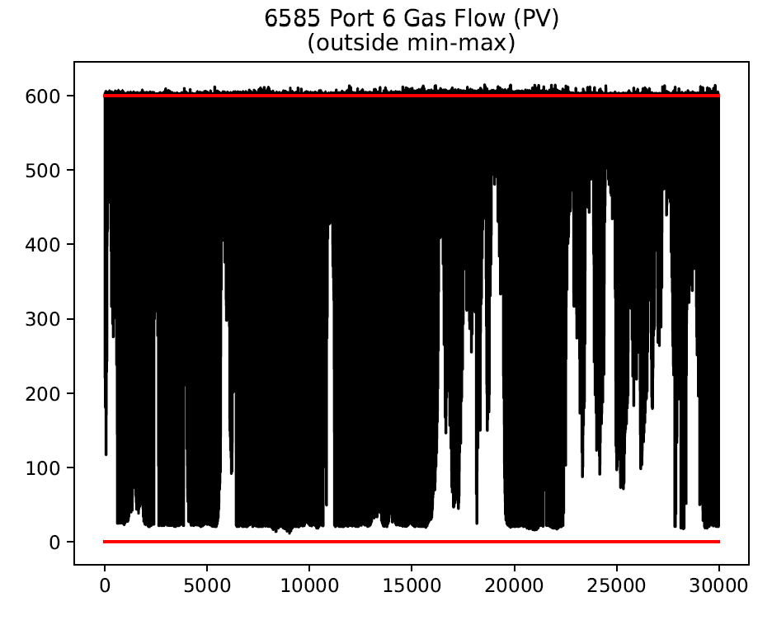
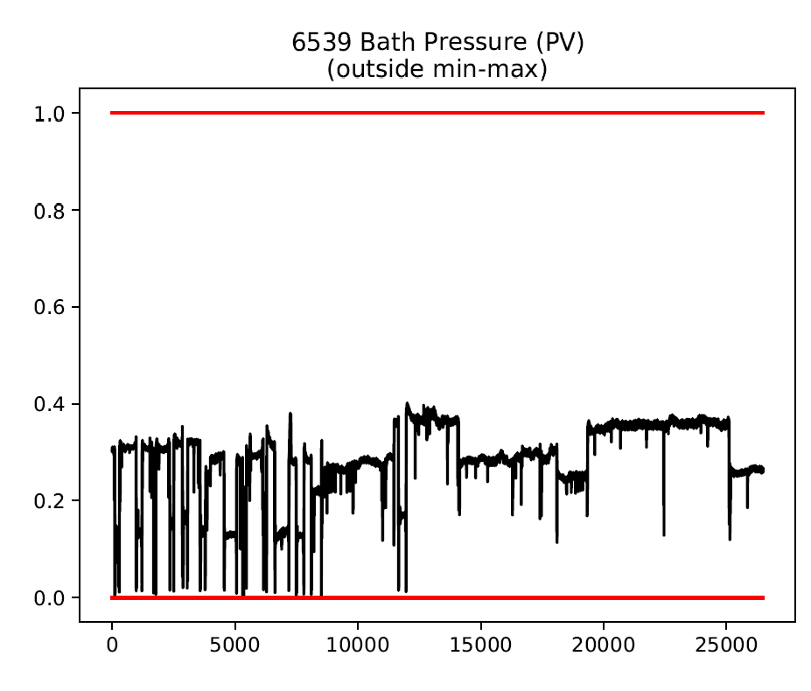

Slide 5
Surprising?
Could let these through?

Slide 6
Load raw tag data if in Mark’s spreadsheet
Isolate to be between 21/09/19 and 25/10/19
Signal valid?
Is between mix and max range?
Is it marked as being low resolution?
no
=1
yes
=0
no
yes
Tag data we cannot find
Is it marked as containing spikes?
Does it require low-pass filtering?
no
no
no
Interpolation
Standardise
Time lags
Reversal?
yes
yes
yes
Filter

Slide 7
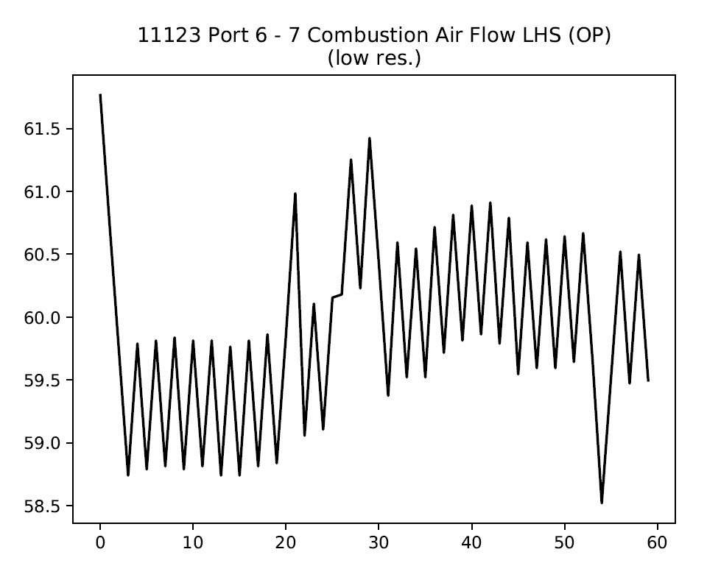
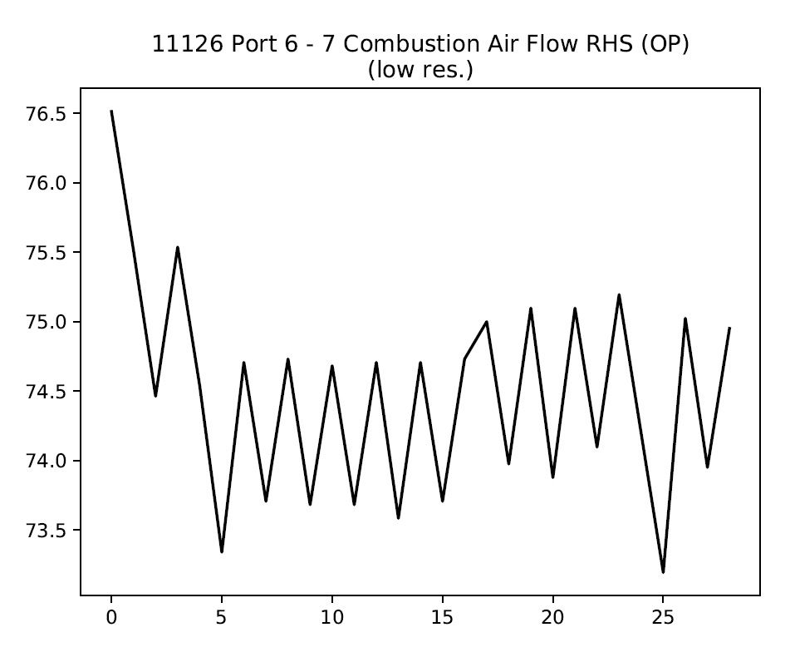
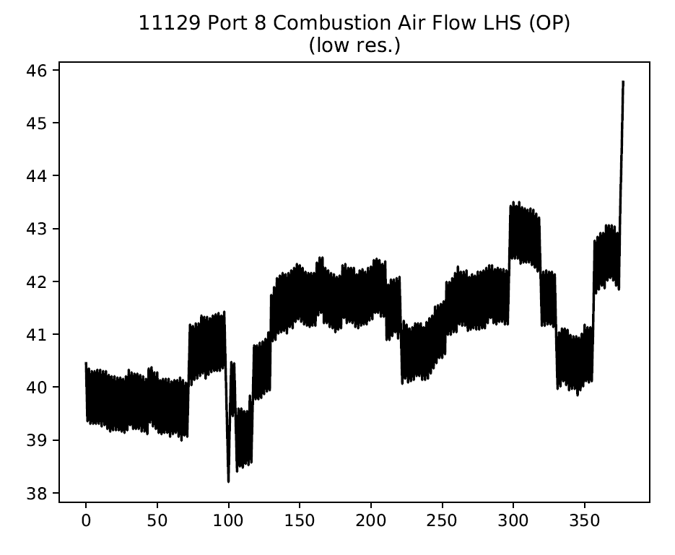
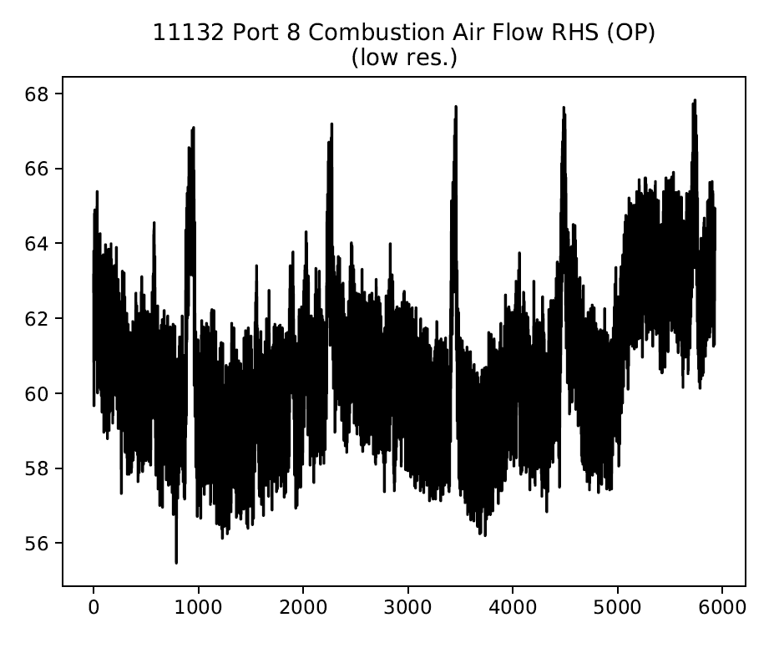
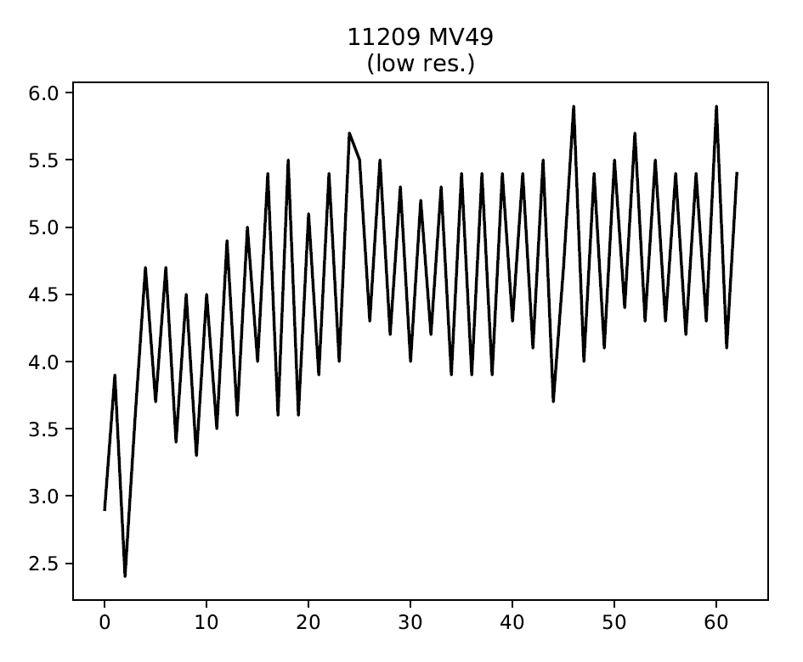
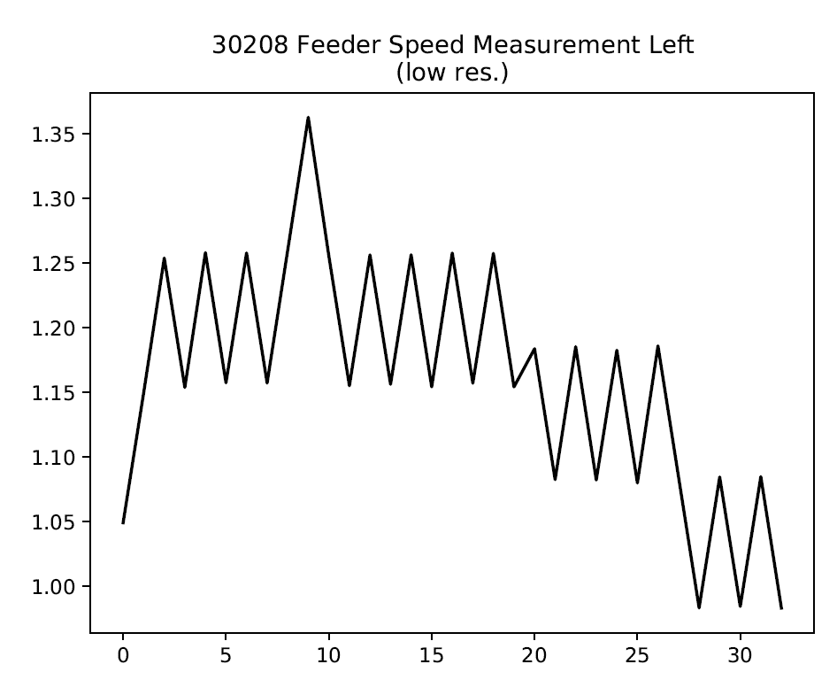

Slide 8
These look OK? Should be spikes?

Slide 9
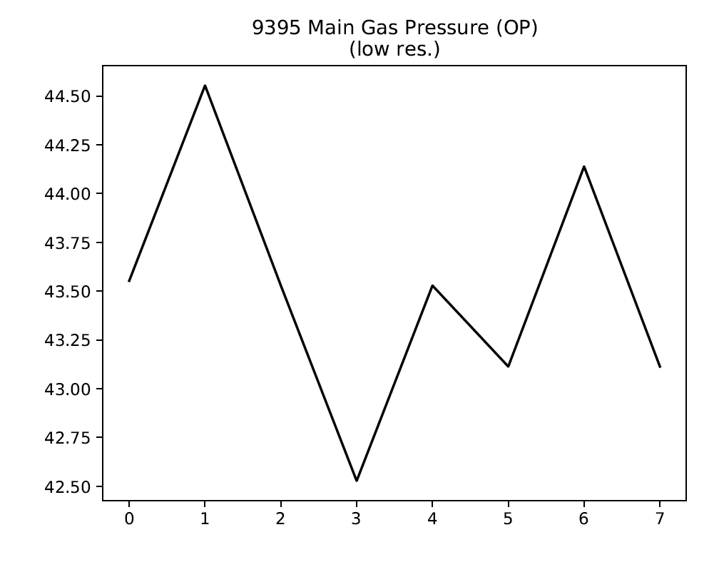
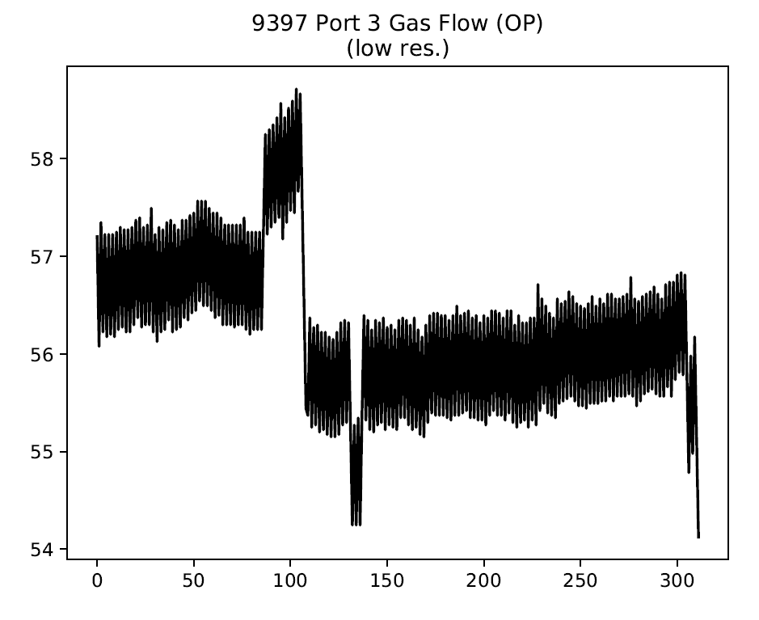
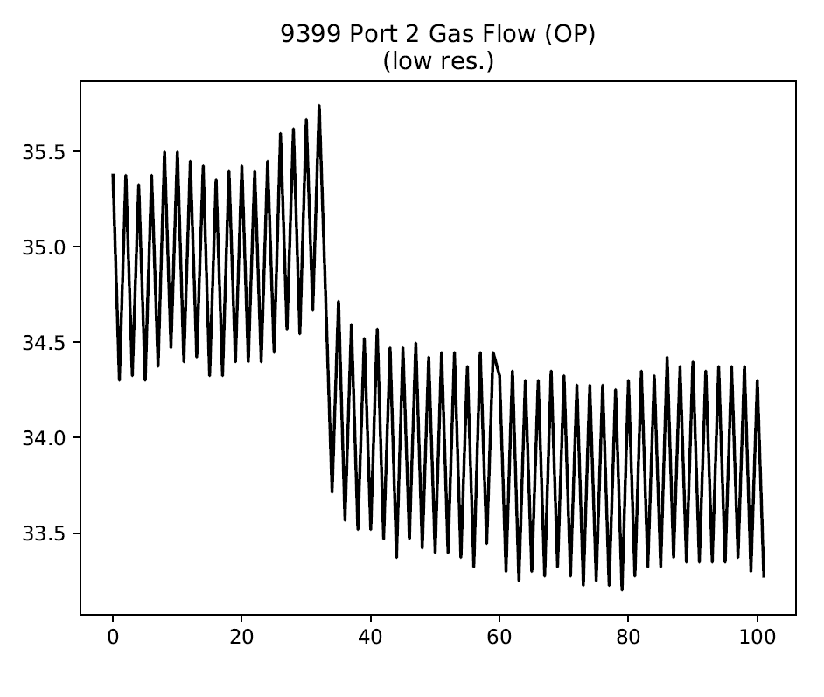
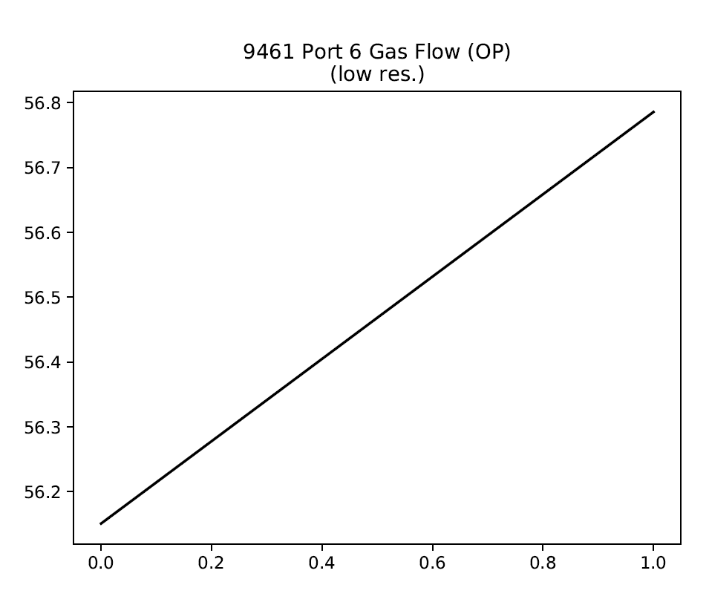
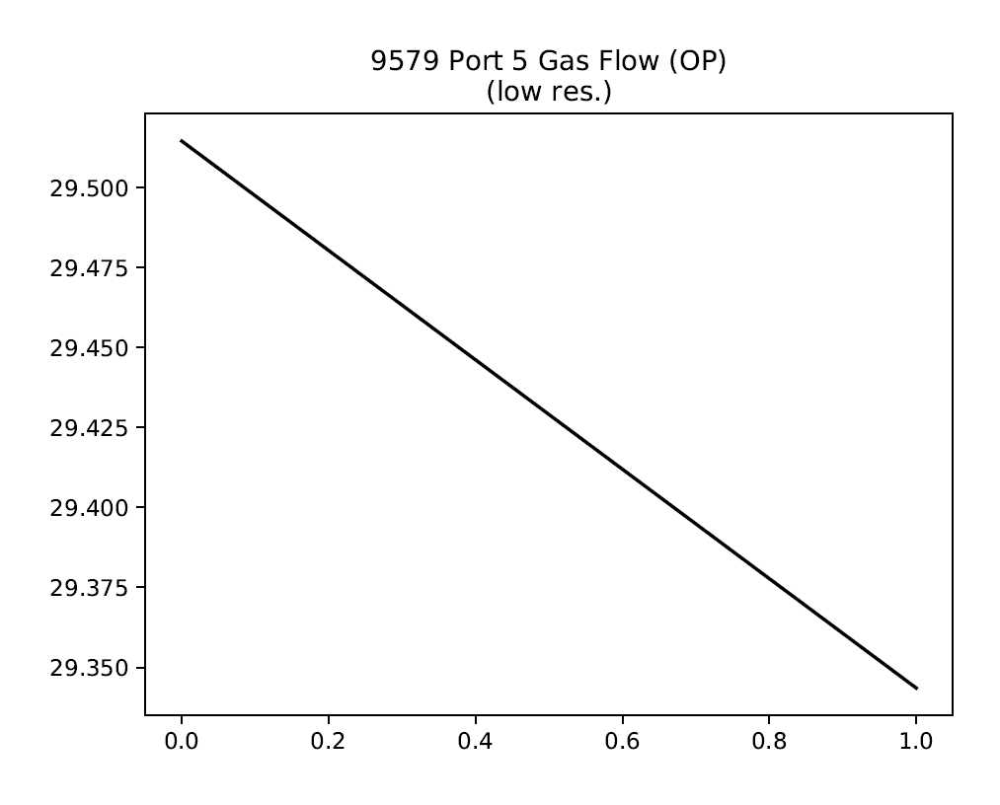
Looks OK?

Slide 10
Load raw tag data if in Mark’s spreadsheet
Isolate to be between 21/09/19 and 25/10/19
Signal valid?
Is between mix and max range?
Is it marked as being low resolution?
no
=1
yes
=0
no
yes
Tag data we cannot find
Is it marked as containing spikes?
Does it require low-pass filtering?
no
no
no
Interpolation
Standardise
Time lags
Reversal?
yes
yes
yes
Filter

Slide 11
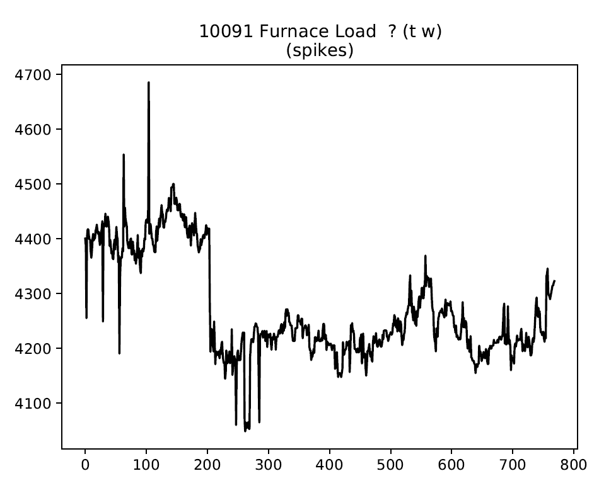
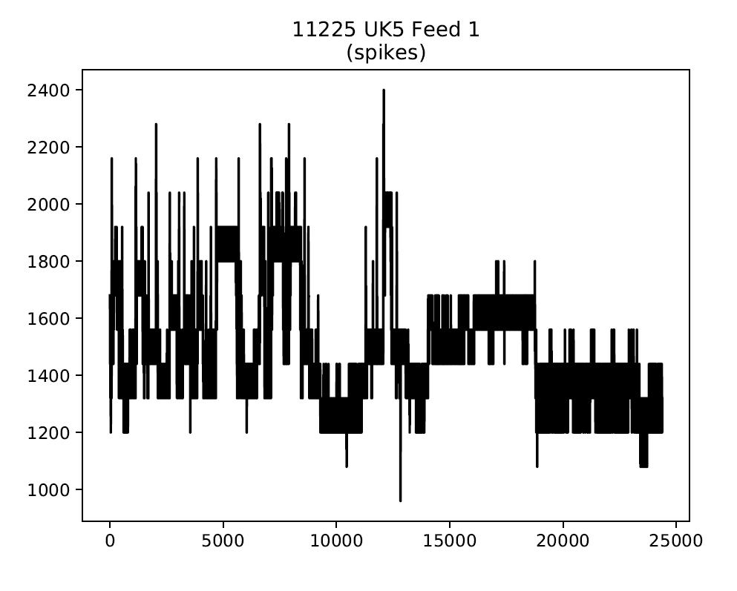
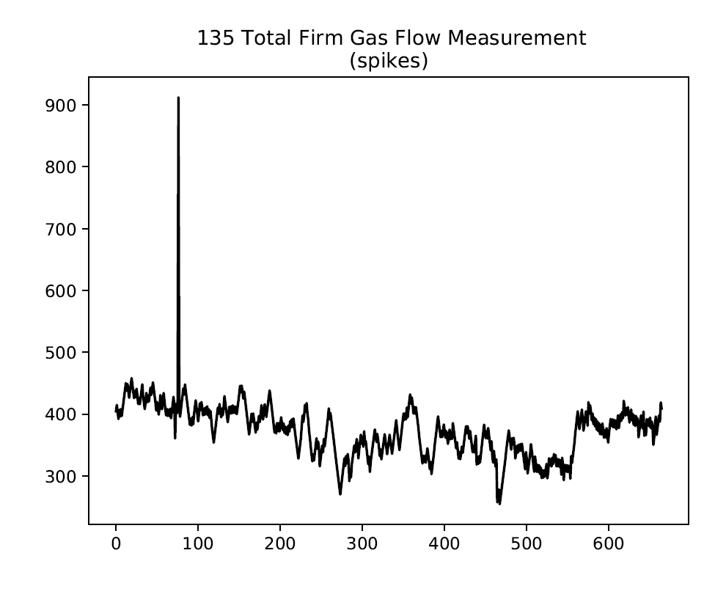
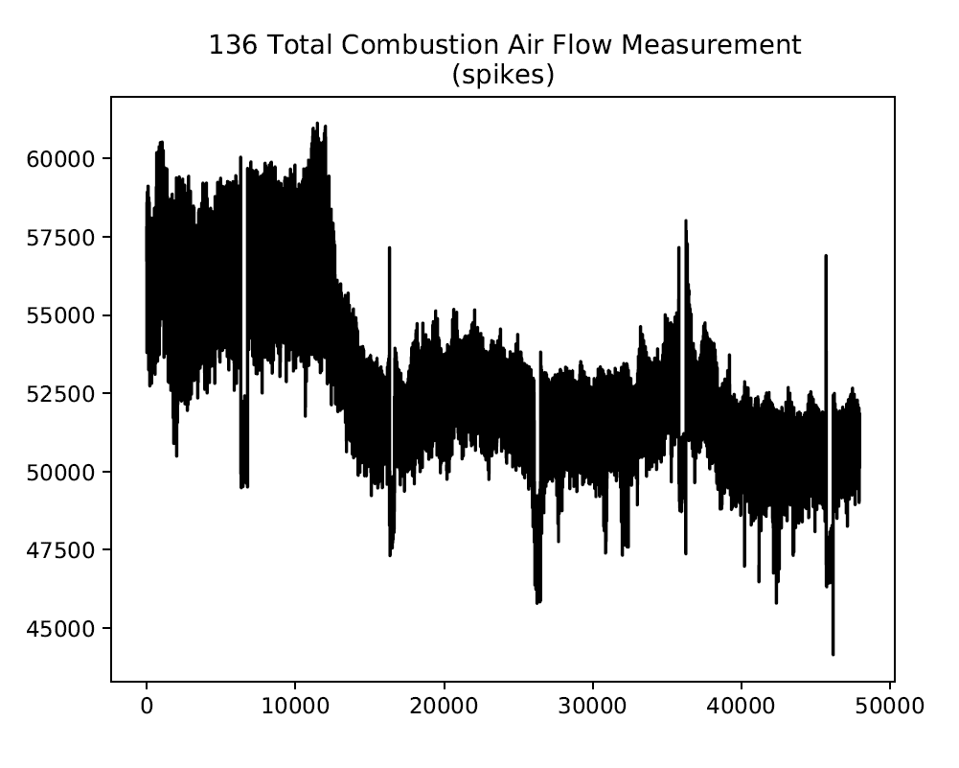
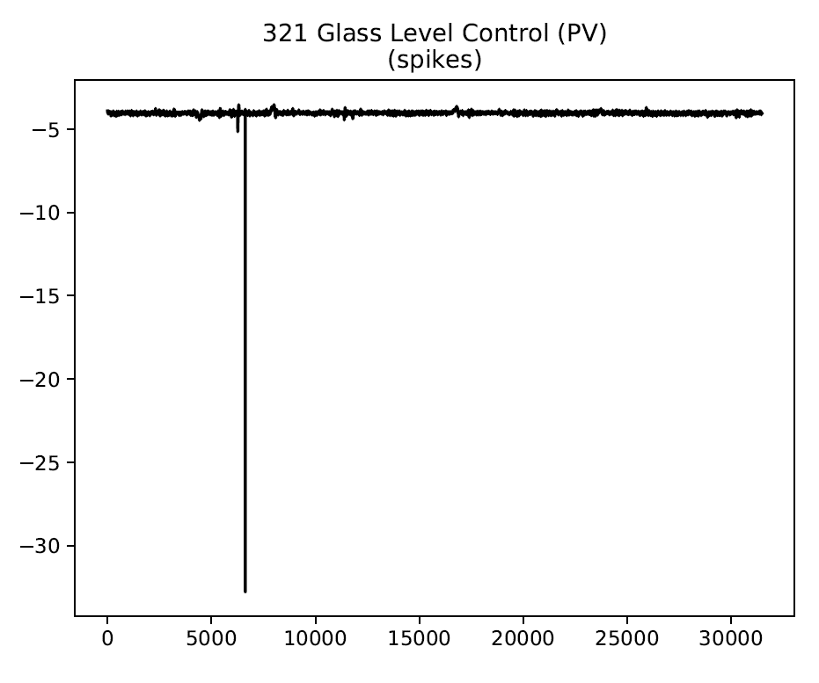
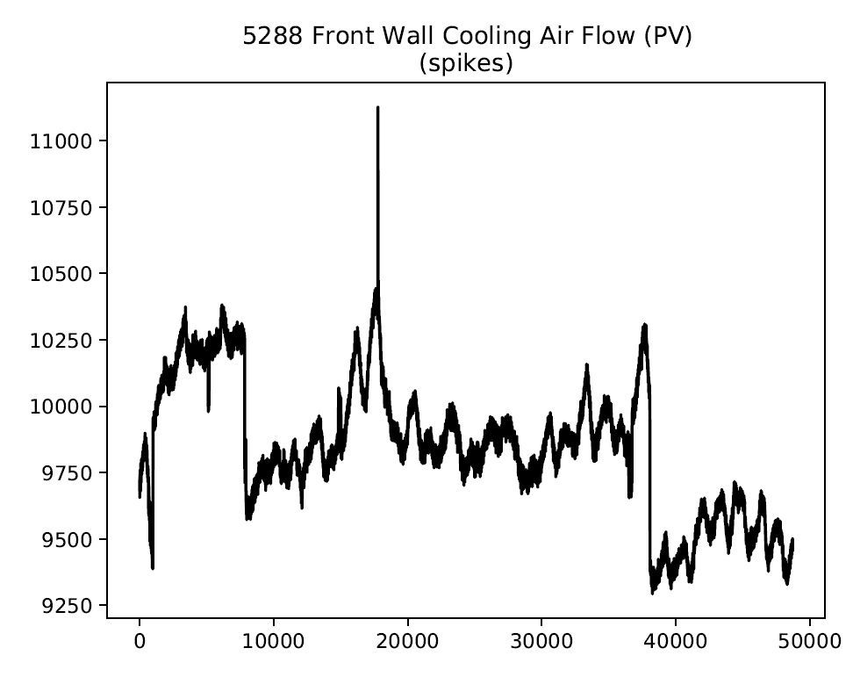

Slide 12
A bit tricky but doable
Low res? Should remove?
A bit tricky but doable
A bit tricky but doable

Slide 13
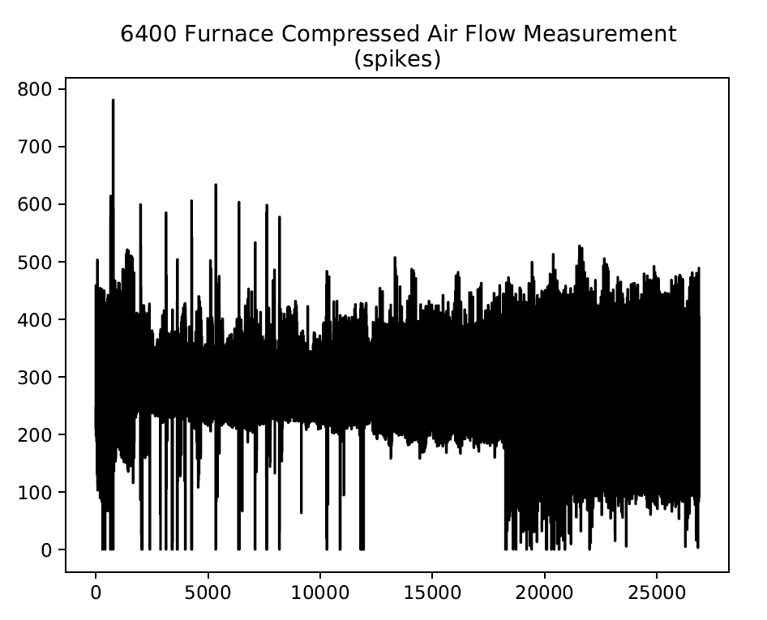
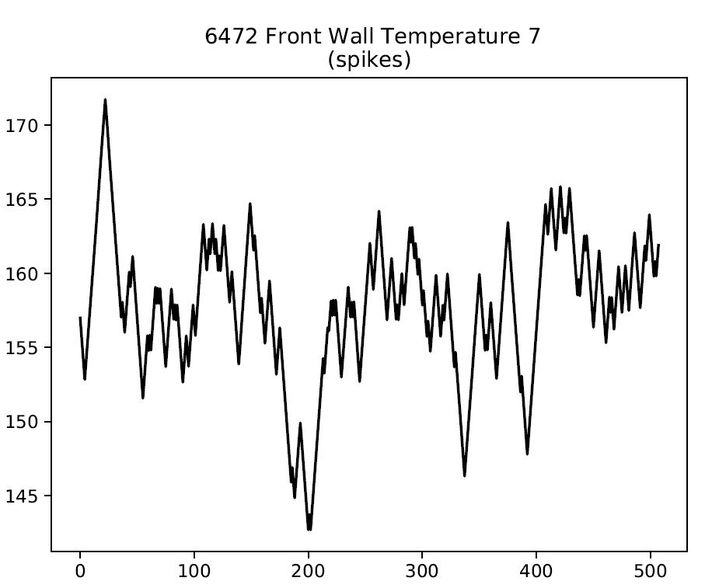

Slide 14
Looks odd?

Slide 15
Load raw tag data if in Mark’s spreadsheet
Isolate to be between 21/09/19 and 25/10/19
Signal valid?
Is between mix and max range?
Is it marked as being low resolution?
no
=1
yes
=0
no
yes
Tag data we cannot find
Is it marked as containing spikes?
Does it require low-pass filtering?
no
no
no
Interpolation
Standardise
Time lags
Reversal?
yes
yes
yes
Filter

Slide 16
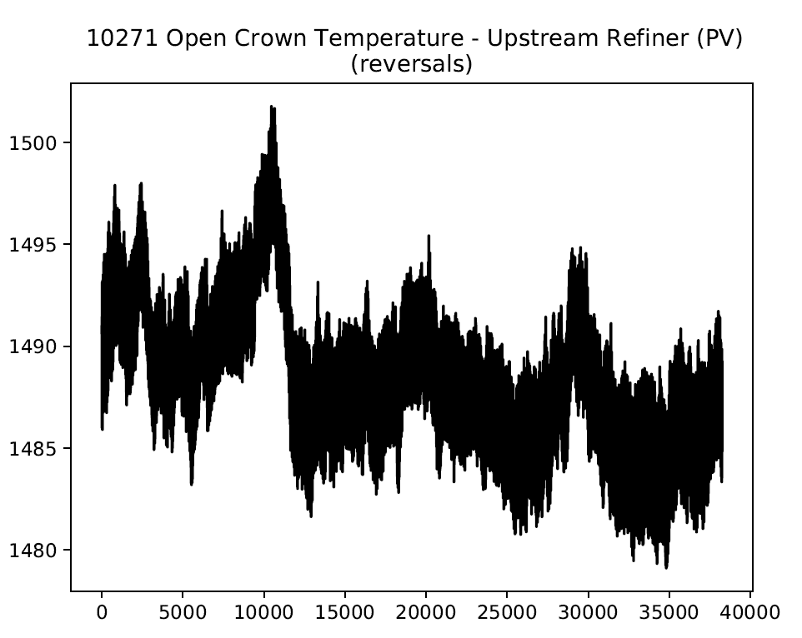
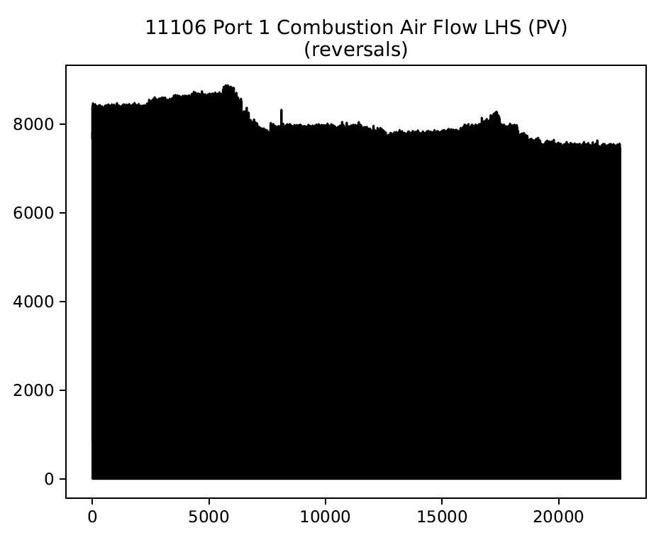
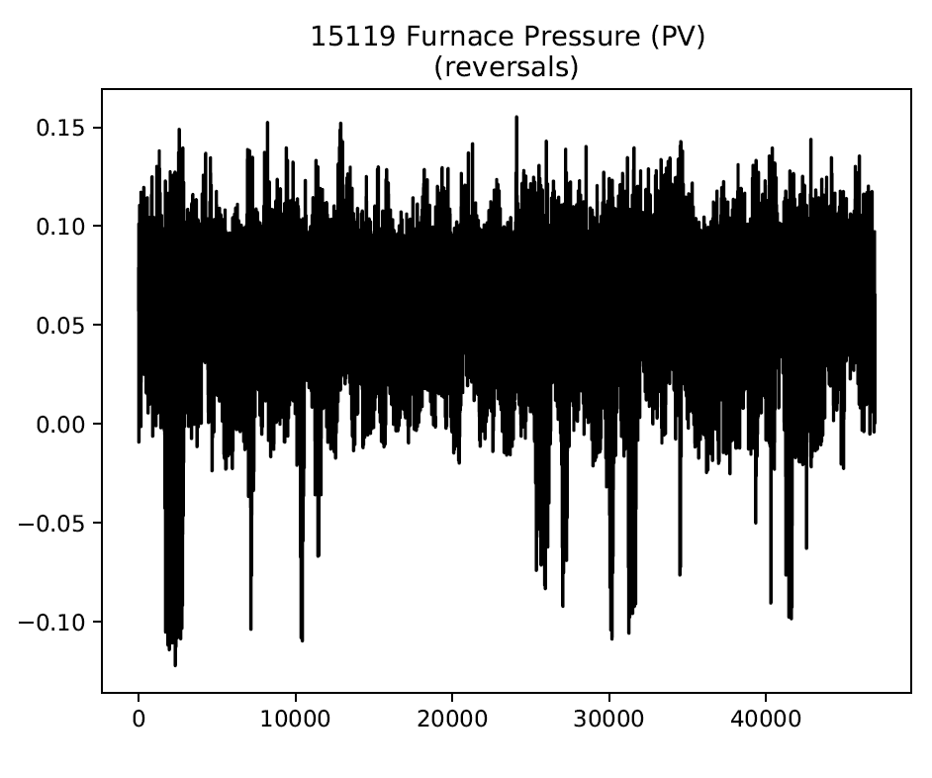
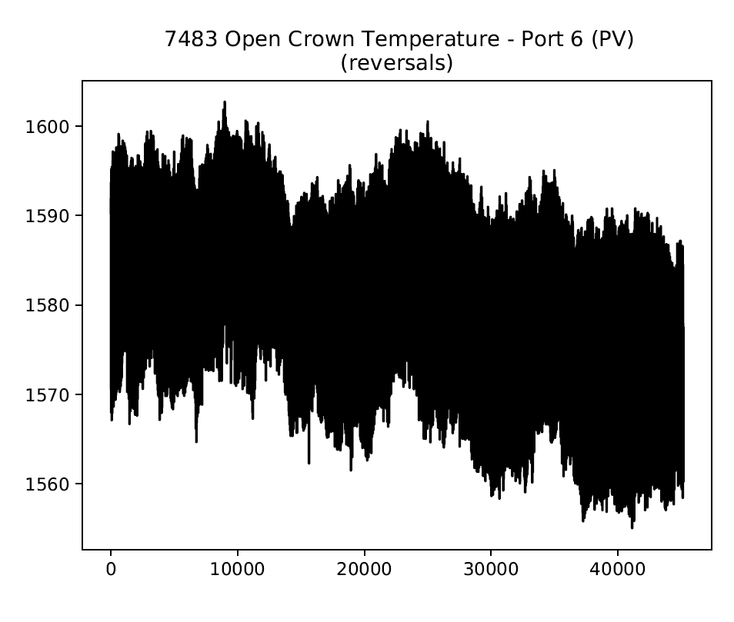
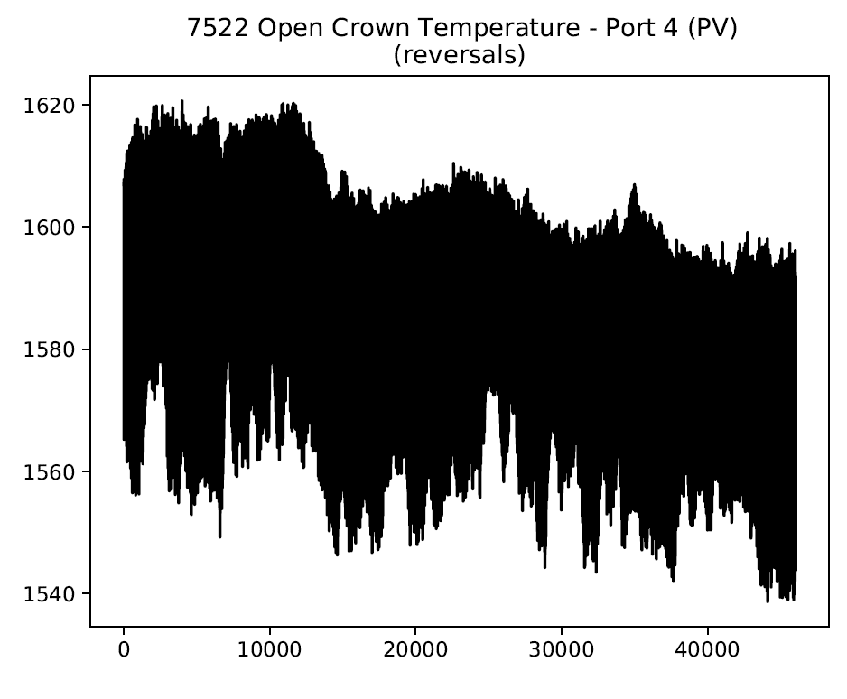
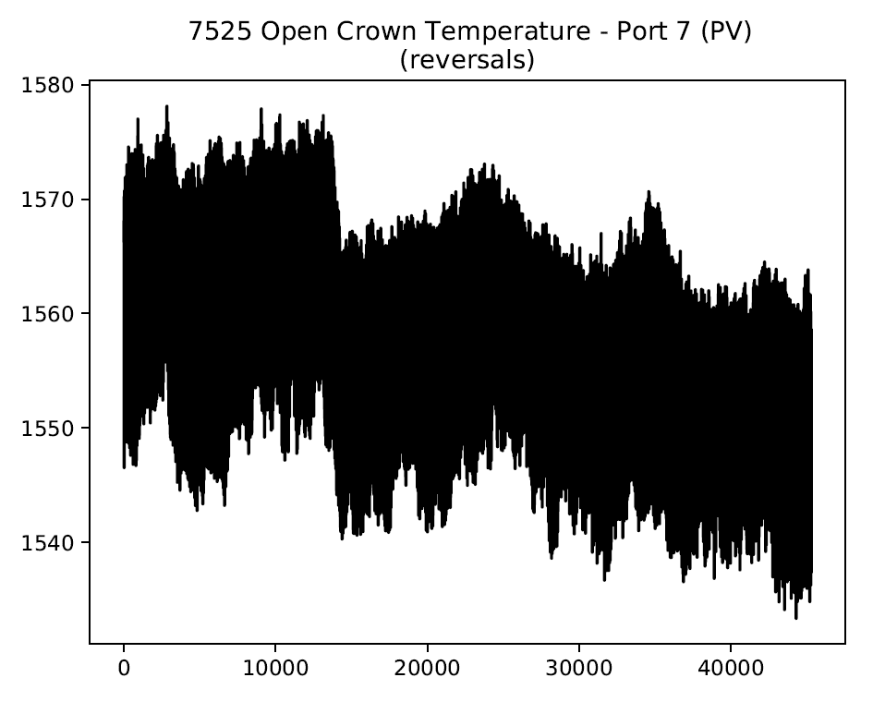

Slide 17
Need counterpart?
Keep drift?

Slide 18
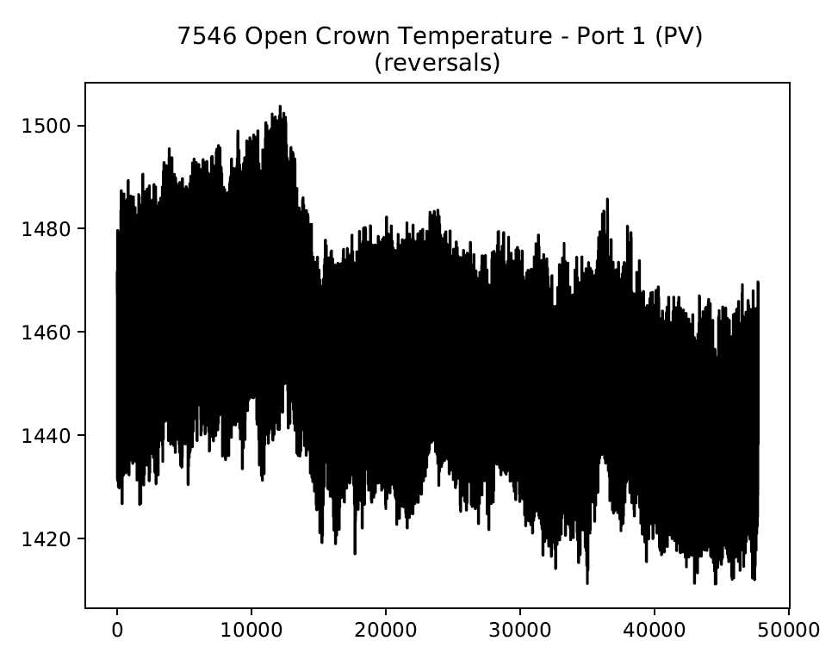
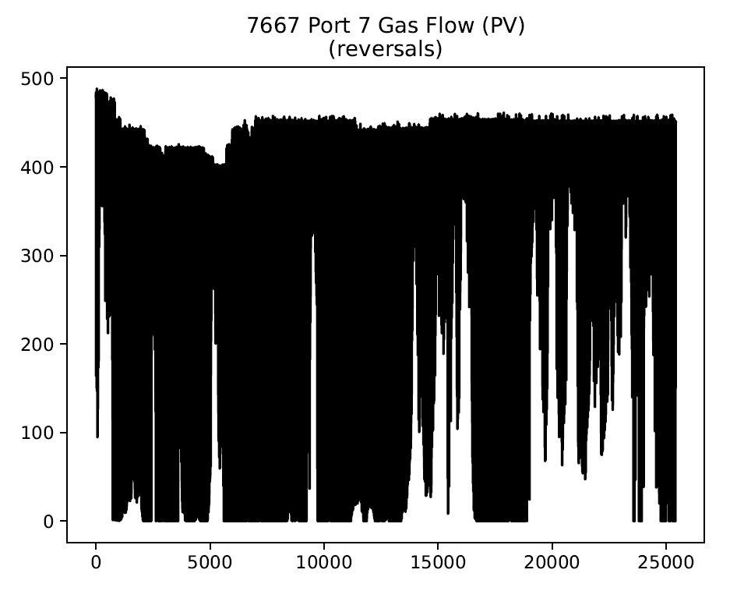
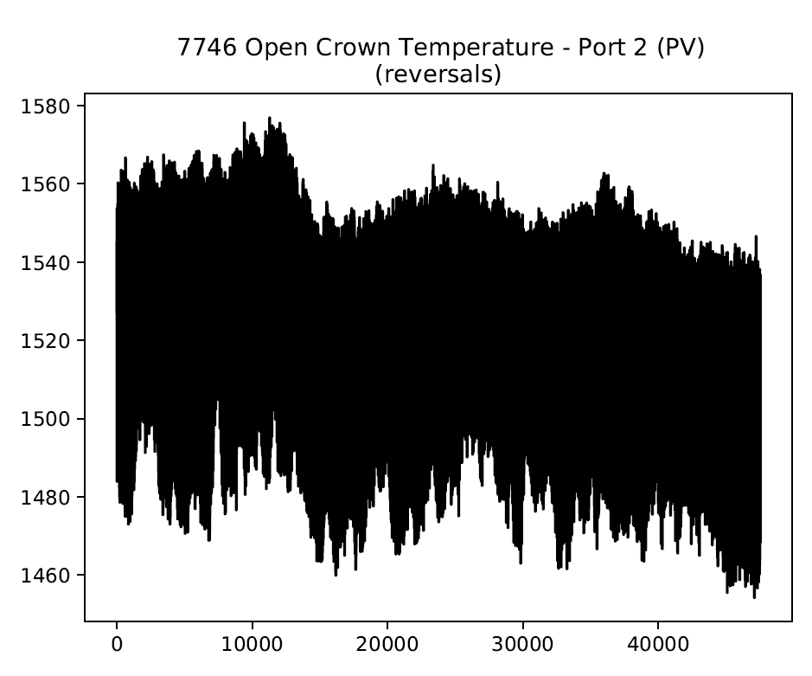
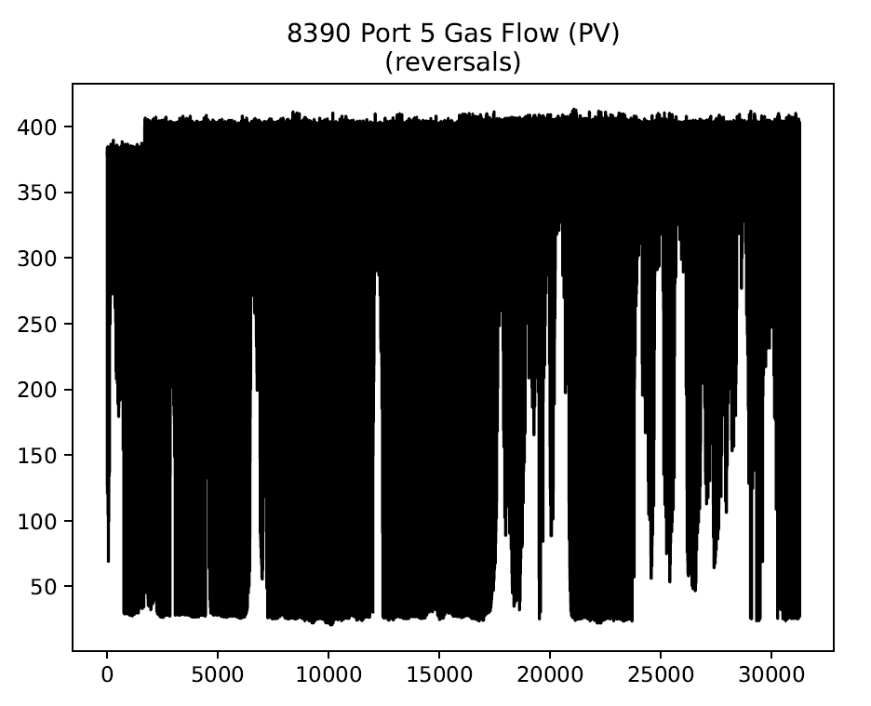
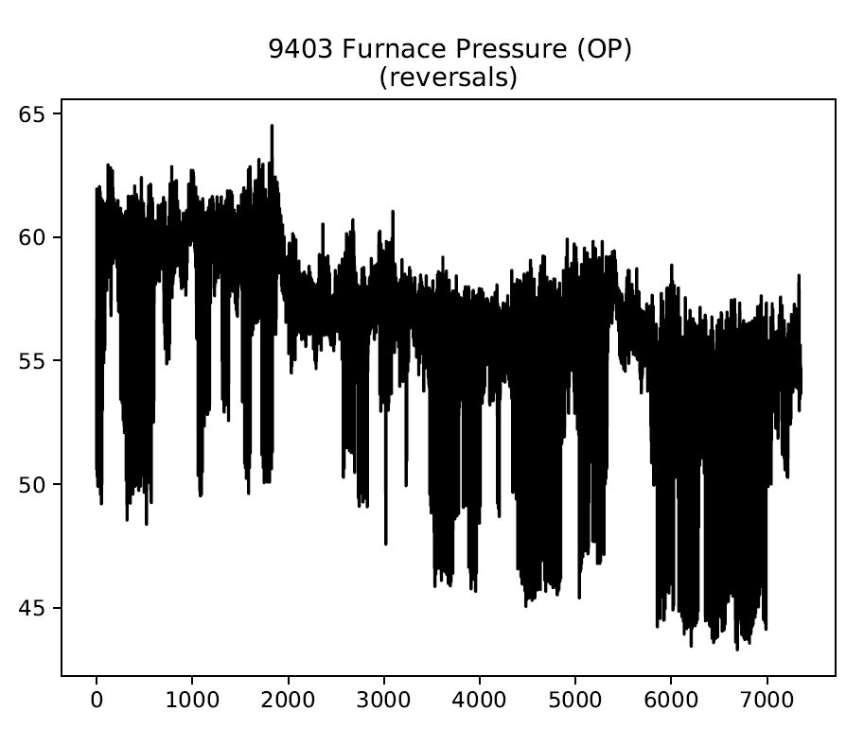
Need counterpart?
Keep drift?

Slide 19
Load raw tag data if in Mark’s spreadsheet
Isolate to be between 21/09/19 and 25/10/19
Signal valid?
Is between mix and max range?
Is it marked as being low resolution?
no
=1
yes
=0
no
yes
Tag data we cannot find
Is it marked as containing spikes?
Does it require low-pass filtering?
no
no
no
Interpolation
Standardise
Time lags
Reversal?
yes
yes
yes
Filter

Slide 20
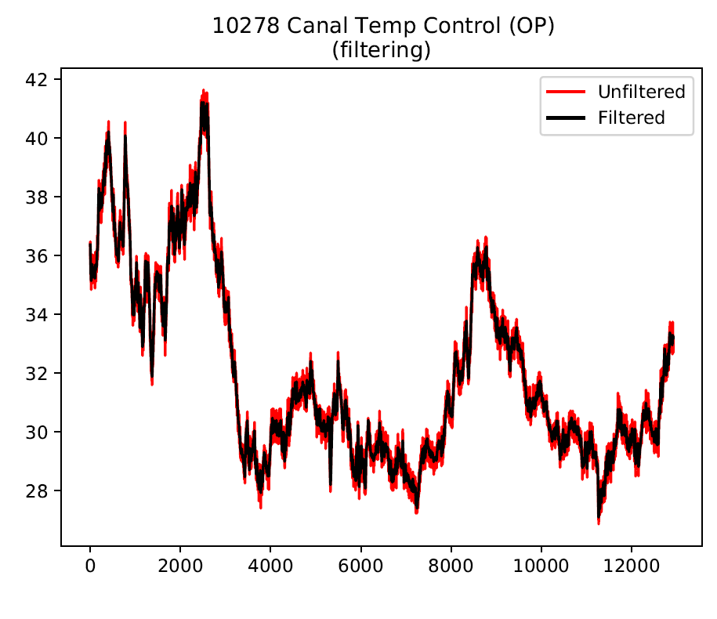
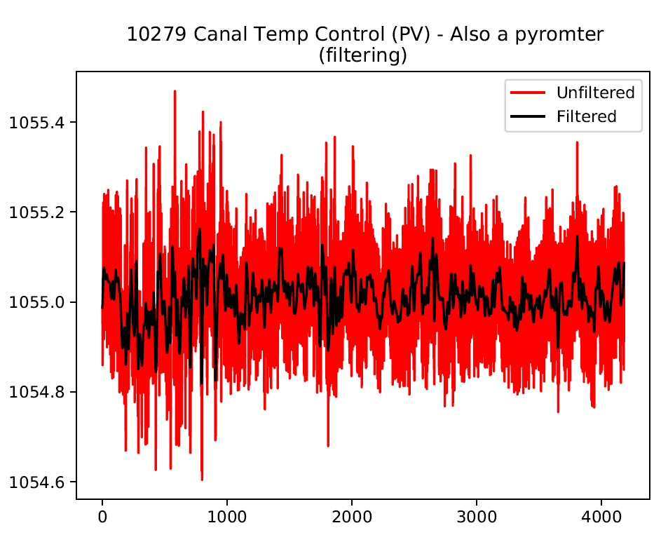
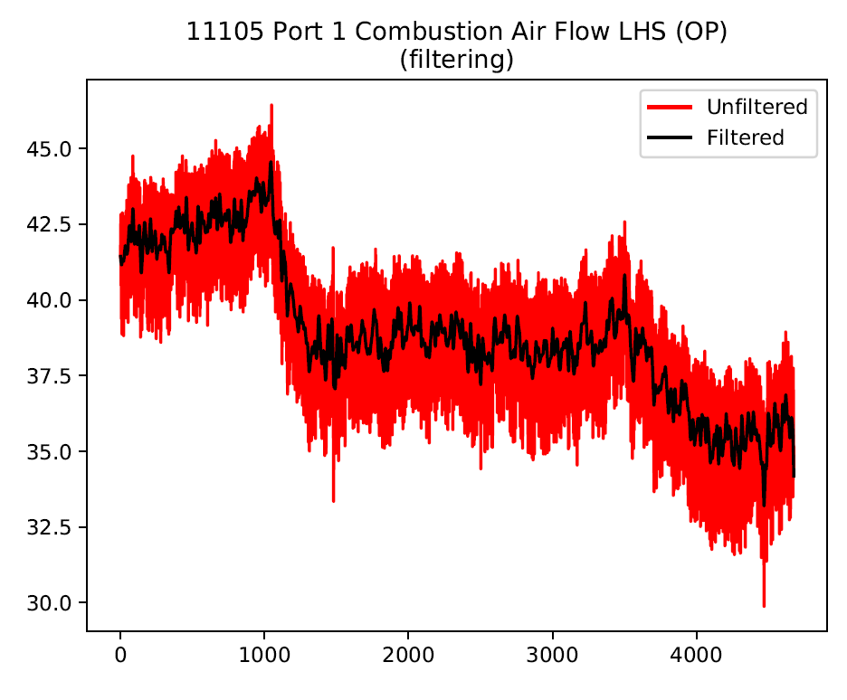
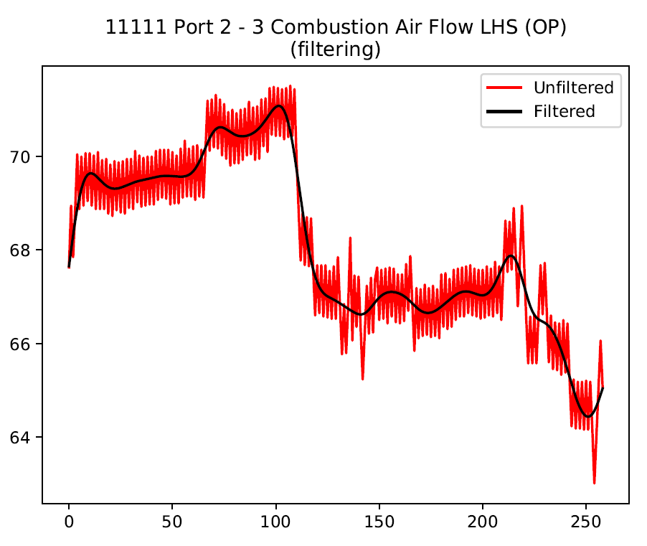
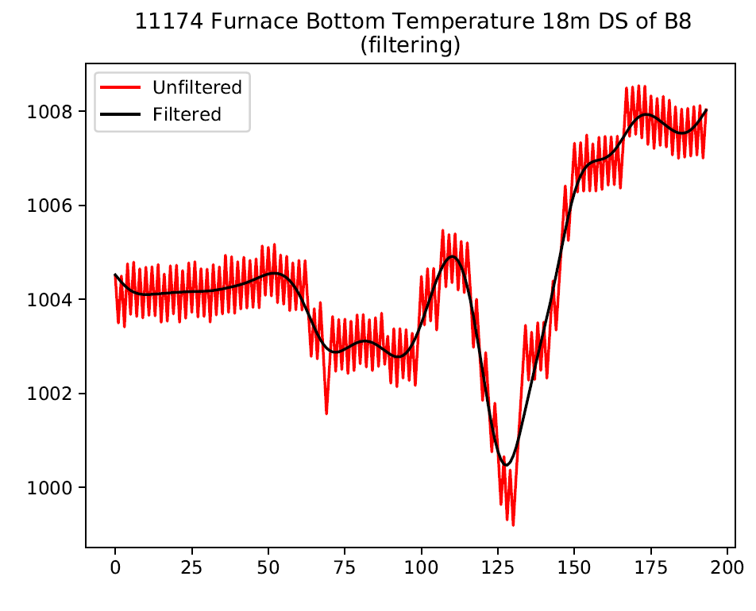
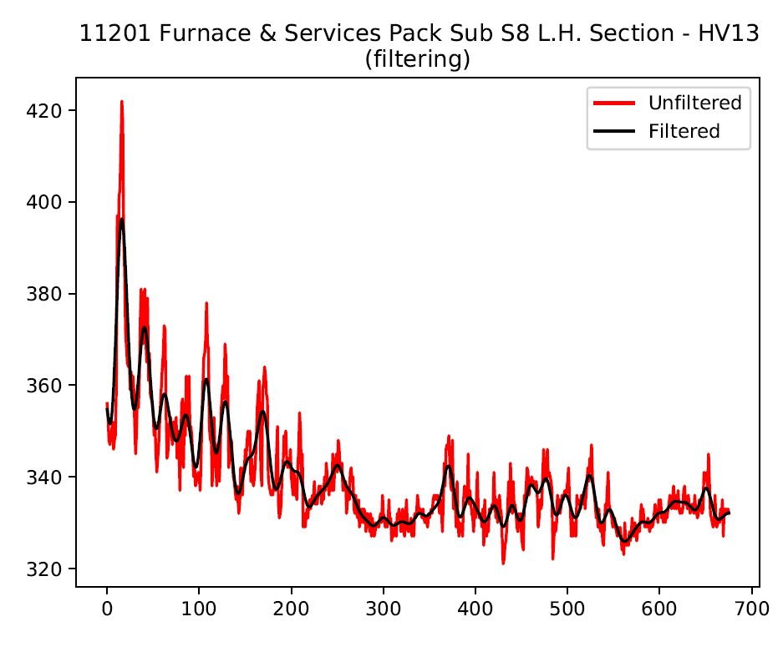

Slide 21
Low res?
Keep in?

Slide 22
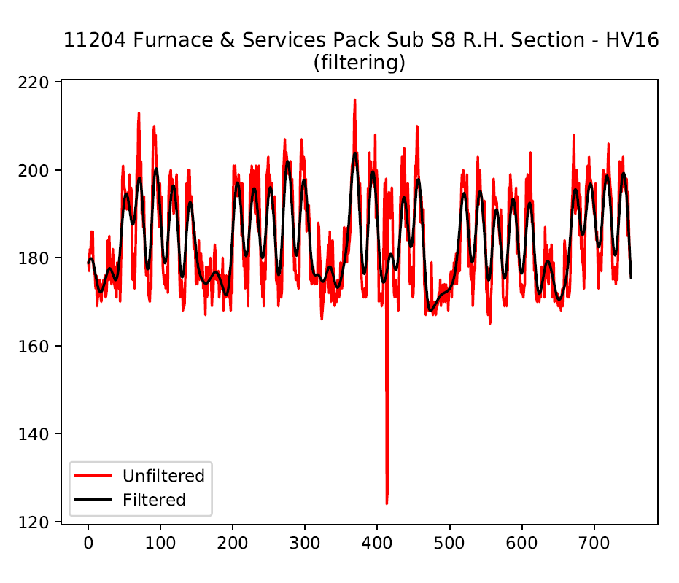
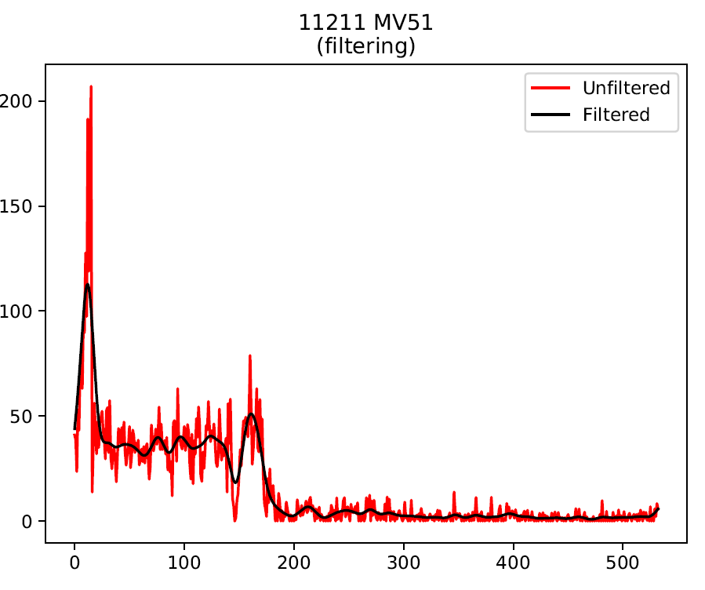
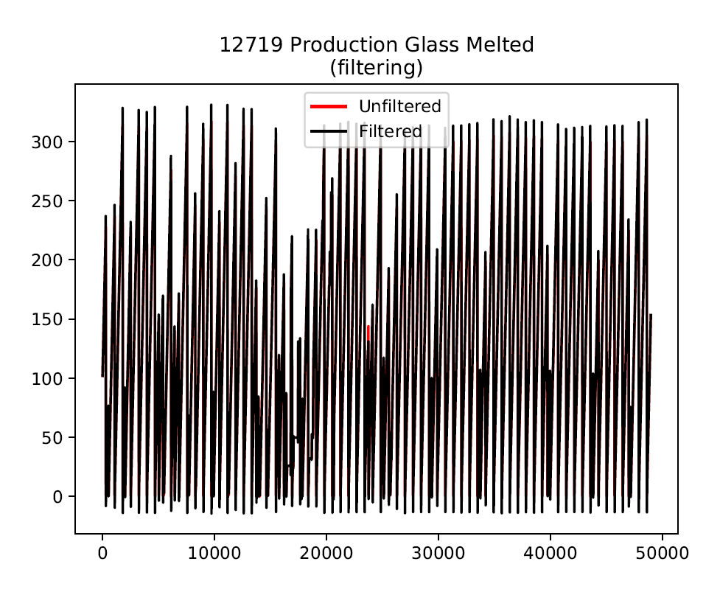
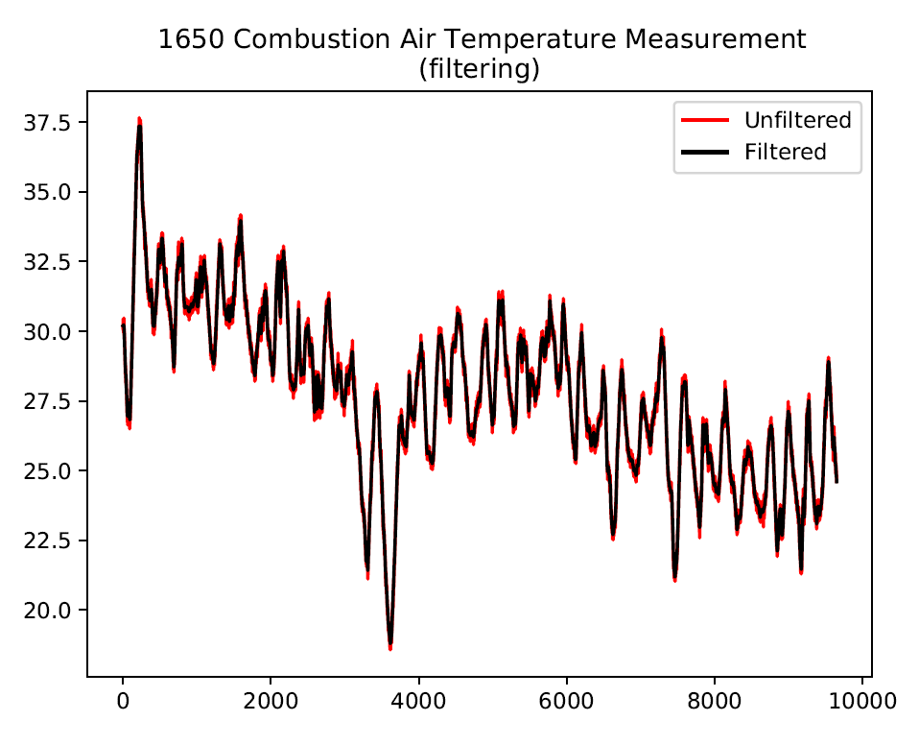
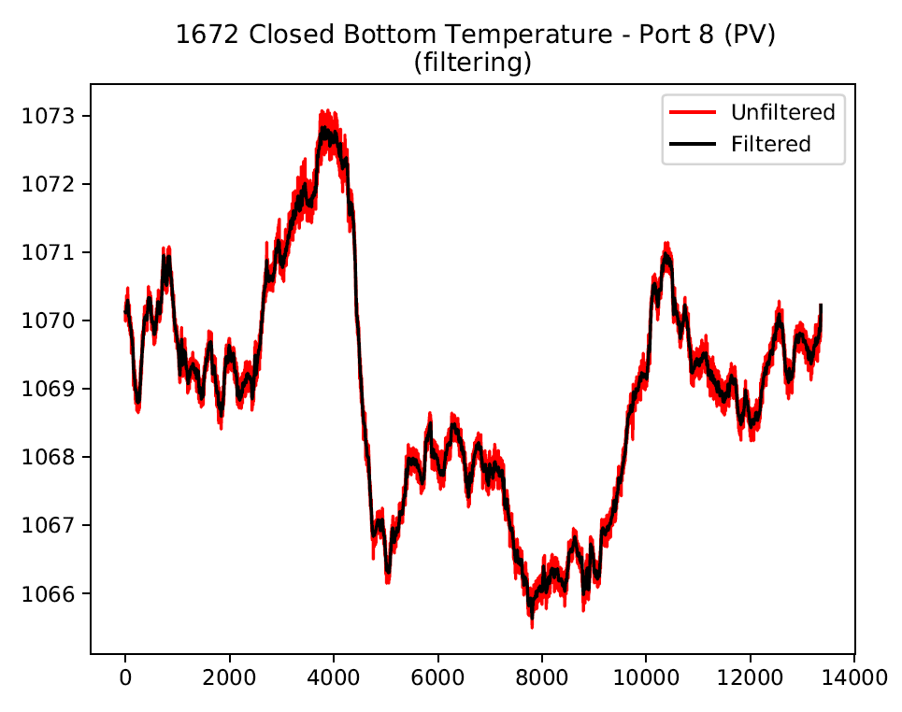
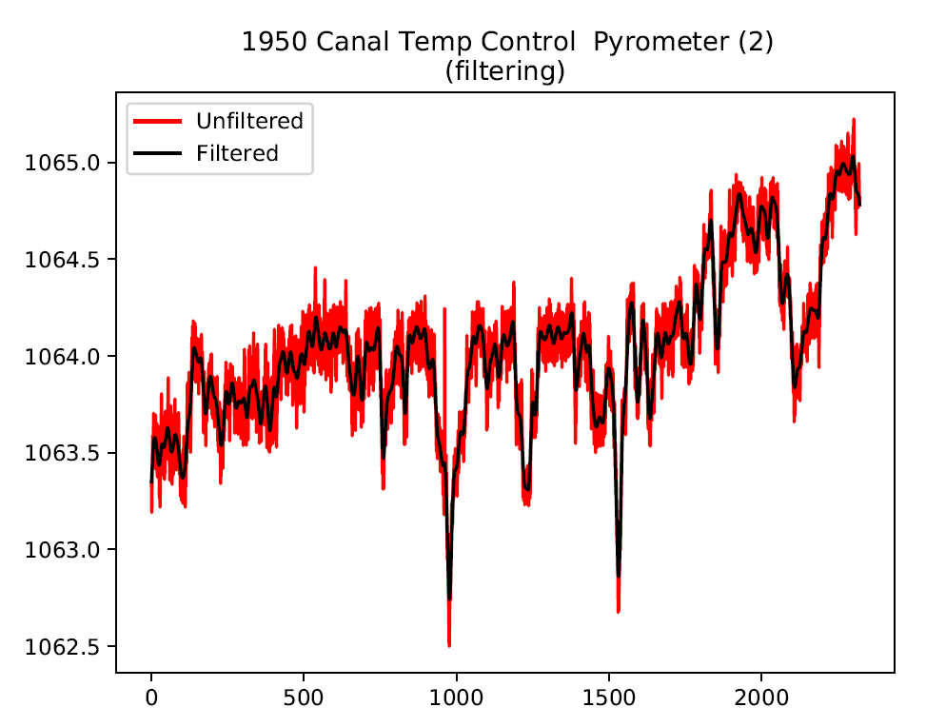

Slide 23
Keep in?
Spike?

Slide 24
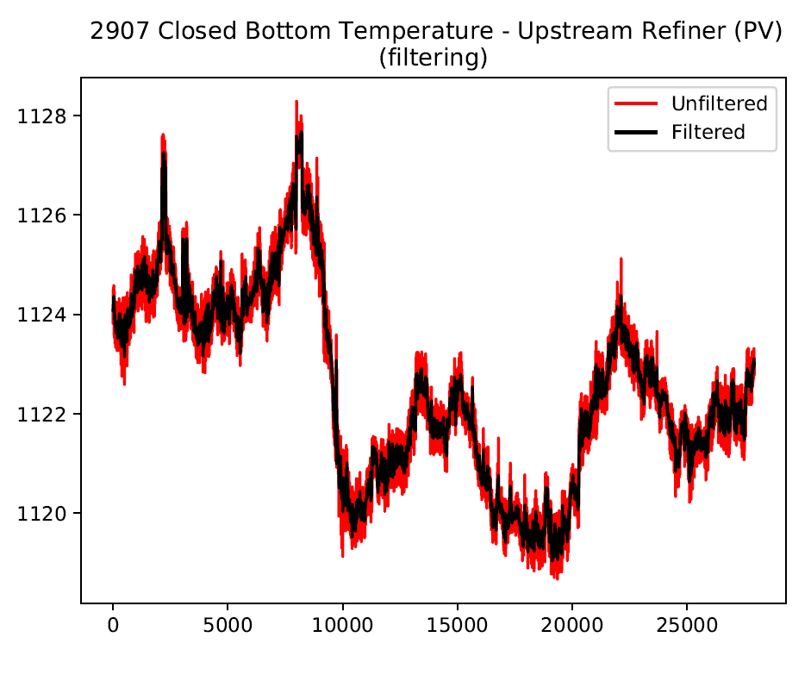
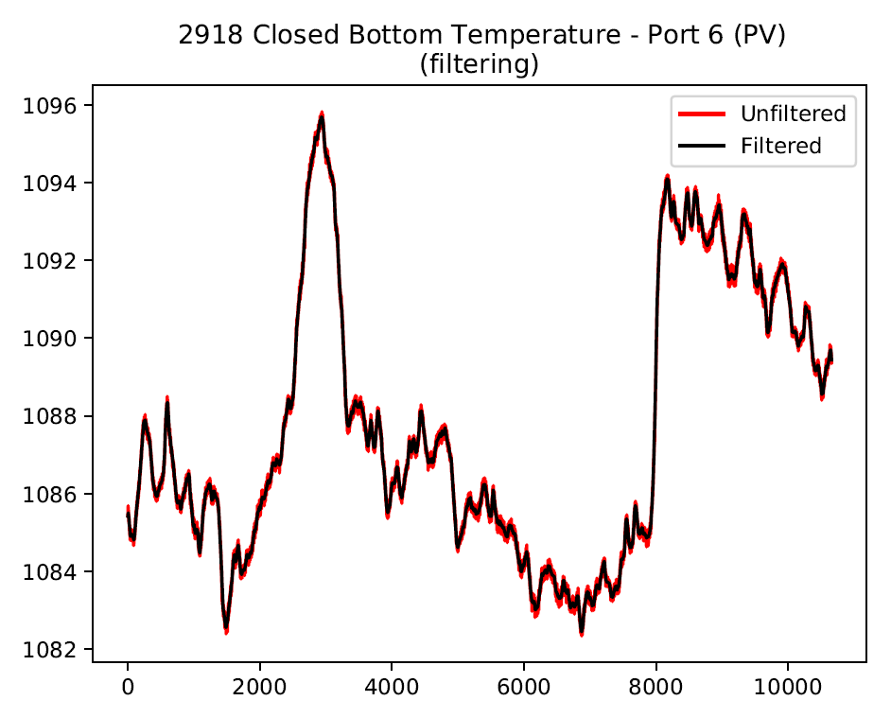





Slide 25
Too much noise?
Low res?

Slide 26






Slide 27
Windspeed?
Too noisy?

Slide 28
Load raw tag data if in Mark’s spreadsheet
Isolate to be between 21/09/19 and 25/10/19
Signal valid?
Is between mix and max range?
Is it marked as being low resolution?
no
=1
yes
=0
no
yes
Tag data we cannot find
Is it marked as containing spikes?
Does it require low-pass filtering?
no
no
no
Interpolation
Standardise
Time lags
Reversal?
yes
yes
yes
Filter

Slide 29







Slide 30
Remove?

Slide 31







Slide 32
Remove?

Slide 33







Slide 34
Remove?

Slide 35







Slide 36







Slide 37
Remove?

Slide 38




Slide 39
Remove?

Slide 40

Final note on test-drive code development
From now on, every time we make and improvement / correction we should think of a suitable test that the new code should pass.
Will take a bit longer now but will be better for us in the long-run.

Slide 41
Thank you for your attention. ANY QUESTIONS?

